Slide 1

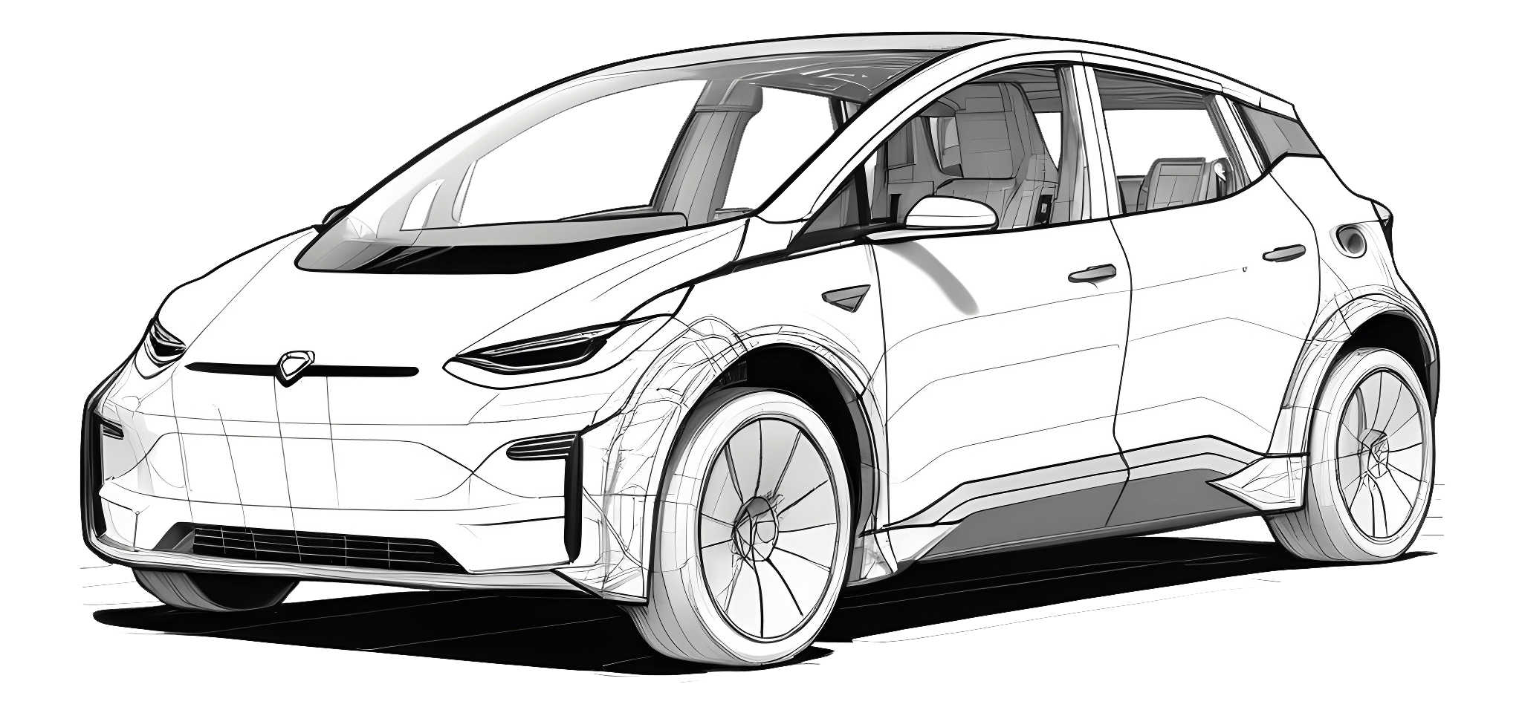
VITYARTHI PROJECT (CAR MANAGEMENT SYSTEM)
MADE BY- MOHAMMAD.ALI
REG. NUMBER – 25MIB10009

Slide 2
INDEX
1 | PROBLEM STATEMENT
2 | DESIGN
3 | CODE/IMPLIMENTATION
4 | CODE/IMPLEMENTATION
5 | DISCUSSION/RESOURCES
6 | REFERENCE

Slide 3

PROBLEM STATEMENT
Organizations and service centers currently struggle with manual methods for managing vehicle and customer data, leading to inefficient workflows, data inaccuracies, and a lack of quick access to crucial information.
This manual approach results in problems such as lost or damaged records, time-consuming data entry and retrieval, and difficulty in generating comprehensive reports, which increases operational costs and reduces customer satisfaction.

Slide 4
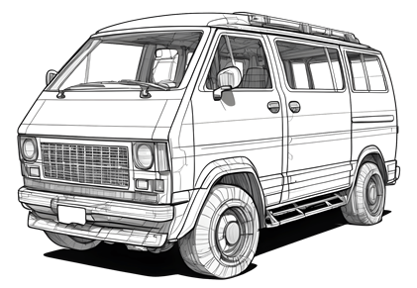
DESIGN
1. Main Menu (Function: main_menu)
START
Initialize global DataFrame df to None.
Check if CAR_SALES.csv exists. If yes, call READ CSV FILE (Step 2) automatically.
Loop (Main Menu): a. Display Main Menu options (1. Read CSV File, 2. Data Analysis Menu, 3. Graph Menu, 4. Exit). b. Read user choice. c. If choice is '1': Call READ CSV FILE (Step 2). d. If choice is '2': i. If df is not None: Call DATA ANALYSIS MENU (Step 3). ii. Else: Display "Data not loaded." e. If choice is '3': i. If df is not None: Call GRAPH MENU (Step 4). ii. Else: Display "Data not loaded." f. If choice is '4': Display "Exiting." BREAK LOOP. g. Else: Display "Invalid choice." h. Prompt user to "Press ENTER to continue."
END

Slide 5
DESIGN
2. Read CSV File (Function: read_csv_file)
Read filename from user (defaulting to CAR_SALES.csv).
Attempt to read the CSV into df using pandas.read_csv, setting 'MODEL' as index_col.
Convert all sales columns to numeric types.
If successful: a. Display success message. b. Print the entire DataFrame df and its dimensions.
If error (e.g., FileNotFoundError): a. Display error message.
Return to Main Menu loop.

Slide 6
DESIGN
3. Data Analysis Menu (Function: data_analysis_menu)
Loop (Data Analysis Menu): a. Display Data Analysis Menu options (1 to 8). b. Read user choice. c. If choice is '1': Call SHOW COLUMNS (Step 3.1). d. If choice is '2': Call SHOW TOP ROWS (Step 3.2). e. If choice is '3': Call SHOW BOTTOM ROWS (Step 3.3). f. If choice is '4': Call SHOW SPECIFIC COLUMN (Step 3.4). g. If choice is '5': Call ADD NEW RECORD (Step 3.5). h. If choice is '6': Call DELETE COLUMN (Step 3.6). i. If choice is '7': Call DATA SUMMARY (Step 3.7). j. If choice is '8': BREAK LOOP. k. Else: Display "Invalid choice." l. Prompt user to "Press ENTER to continue.“
Return to Main Menu loop.

Slide 7
DESIGN
3.4. SHOW SPECIFIC COLUMN
Read column_name from user.
If column_name exists in df.columns: Print df[column_name].
Else: Print "Column not found."

Slide 8
DESIGN
3.5. ADD NEW RECORD
Read new_model_name.
If model already exists: Print error.
Else: a. For each year (2015-2020): Read sales value from user. b. Create a new pandas Series from the sales data. c. Add the Series as a new column to df with new_model_name. d. Update global CAR_MODELS and MANUFACTURERS lists. e. Print updated df.
3.6. DELETE COLUMN
Read column_name to delete.
If column_name exists: a. Drop the column using df.drop(columns=[column_name], inplace=True). b. Update global model lists. c. Print updated df.
Else: Print "Column not found."
3.7. DATA SUMMARY

Slide 9
DESIGN
Call df.describe().transpose().
Print the resulting summary table.
4. Graph Menu (Function: graph_menu)
Loop (Graph Menu): a. Display Graph Menu options (1. Line Graph, 2. Bar Graph, 3. Exit) and available Manufacturers. b. Read user choice (graph_choice). c. If graph_choice is '3': BREAK LOOP. d. If graph_choice is '1' or '2': i. Set graph_type ('line' or 'bar'). ii. Prompt user to select a Manufacturer number. iii. Prompt user to select a Car Model number from the selected Manufacturer's list. iv. Retrieve selected_model. v. Call PLOT GRAPH (Step 4.1) with selected_model and graph_type. e. Else: Display "Invalid choice." f. Prompt user to "Press ENTER to continue."
Return to Main Menu loop.

Slide 10
DESIGN
4.1. PLOT GRAPH (Function: plot_graph)
Extract sales data for model from df.
Create matplotlib figure and axes.
Determine the Manufacturer for the title.
If graph_type is 'line': Plot YEARS vs sales_data as a line graph.
If graph_type is 'bar': Plot YEARS vs sales_data as a bar graph.
Set labels, title, and grid.
Display the plot using plt.show().

Slide 11
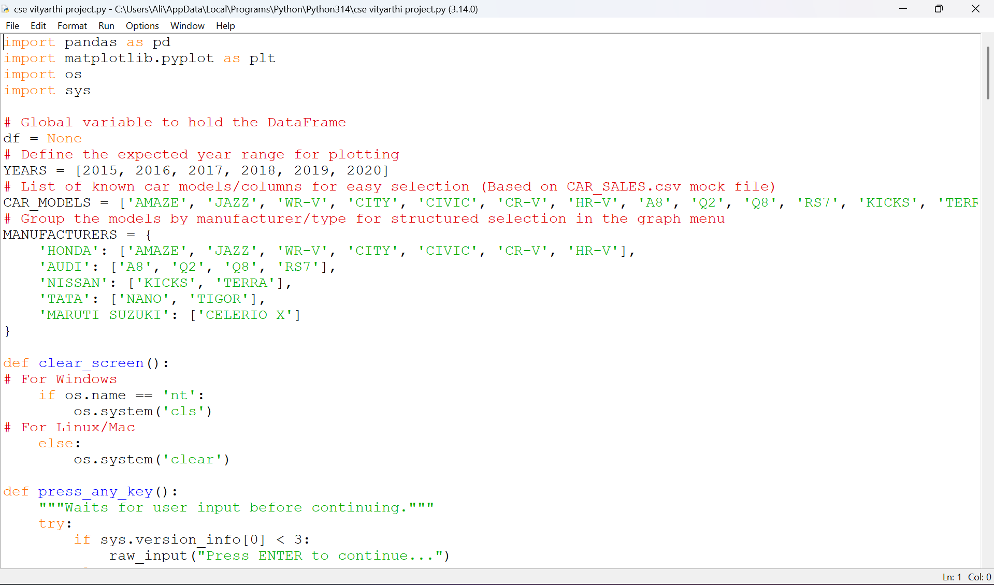
INPUT AND OUTPUT CODE

Slide 12
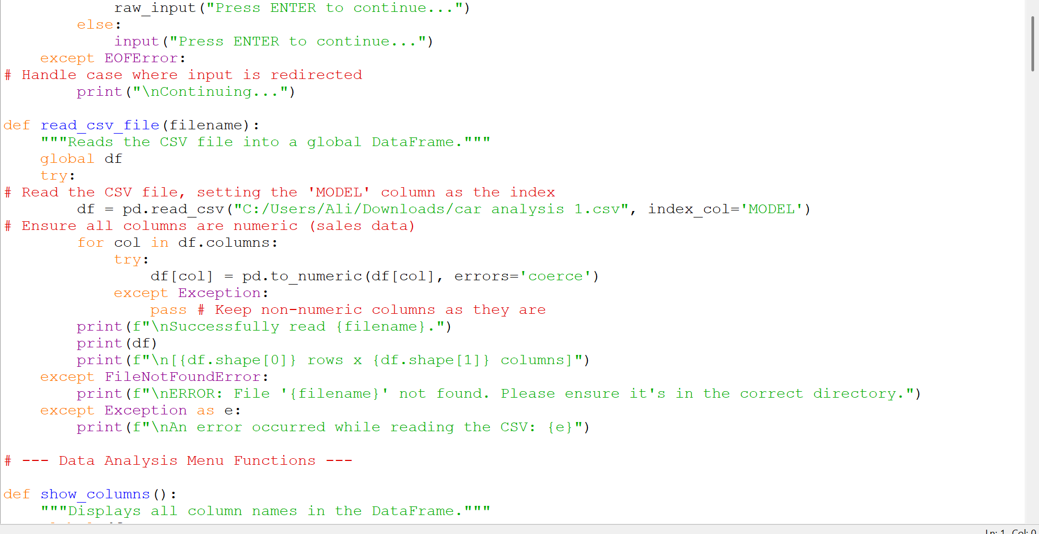

Slide 13
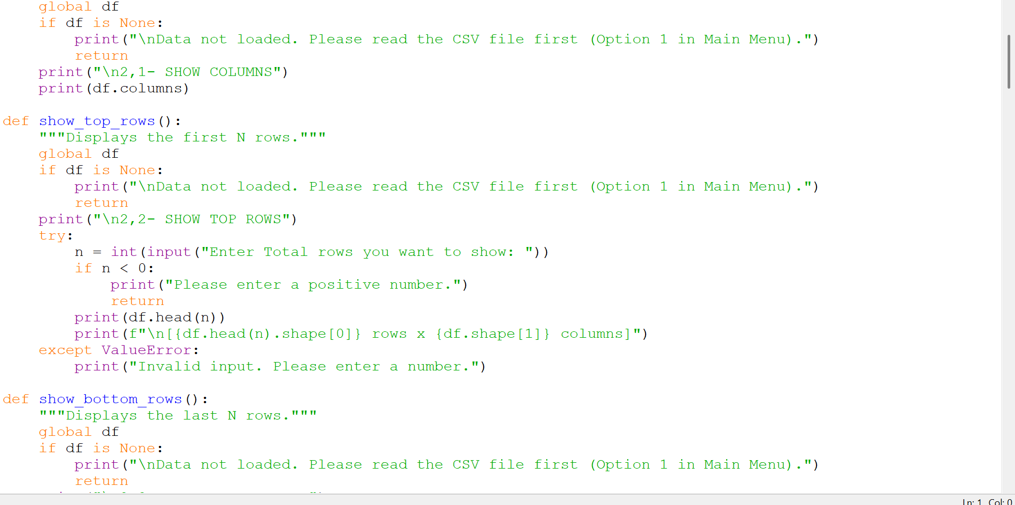

Slide 14
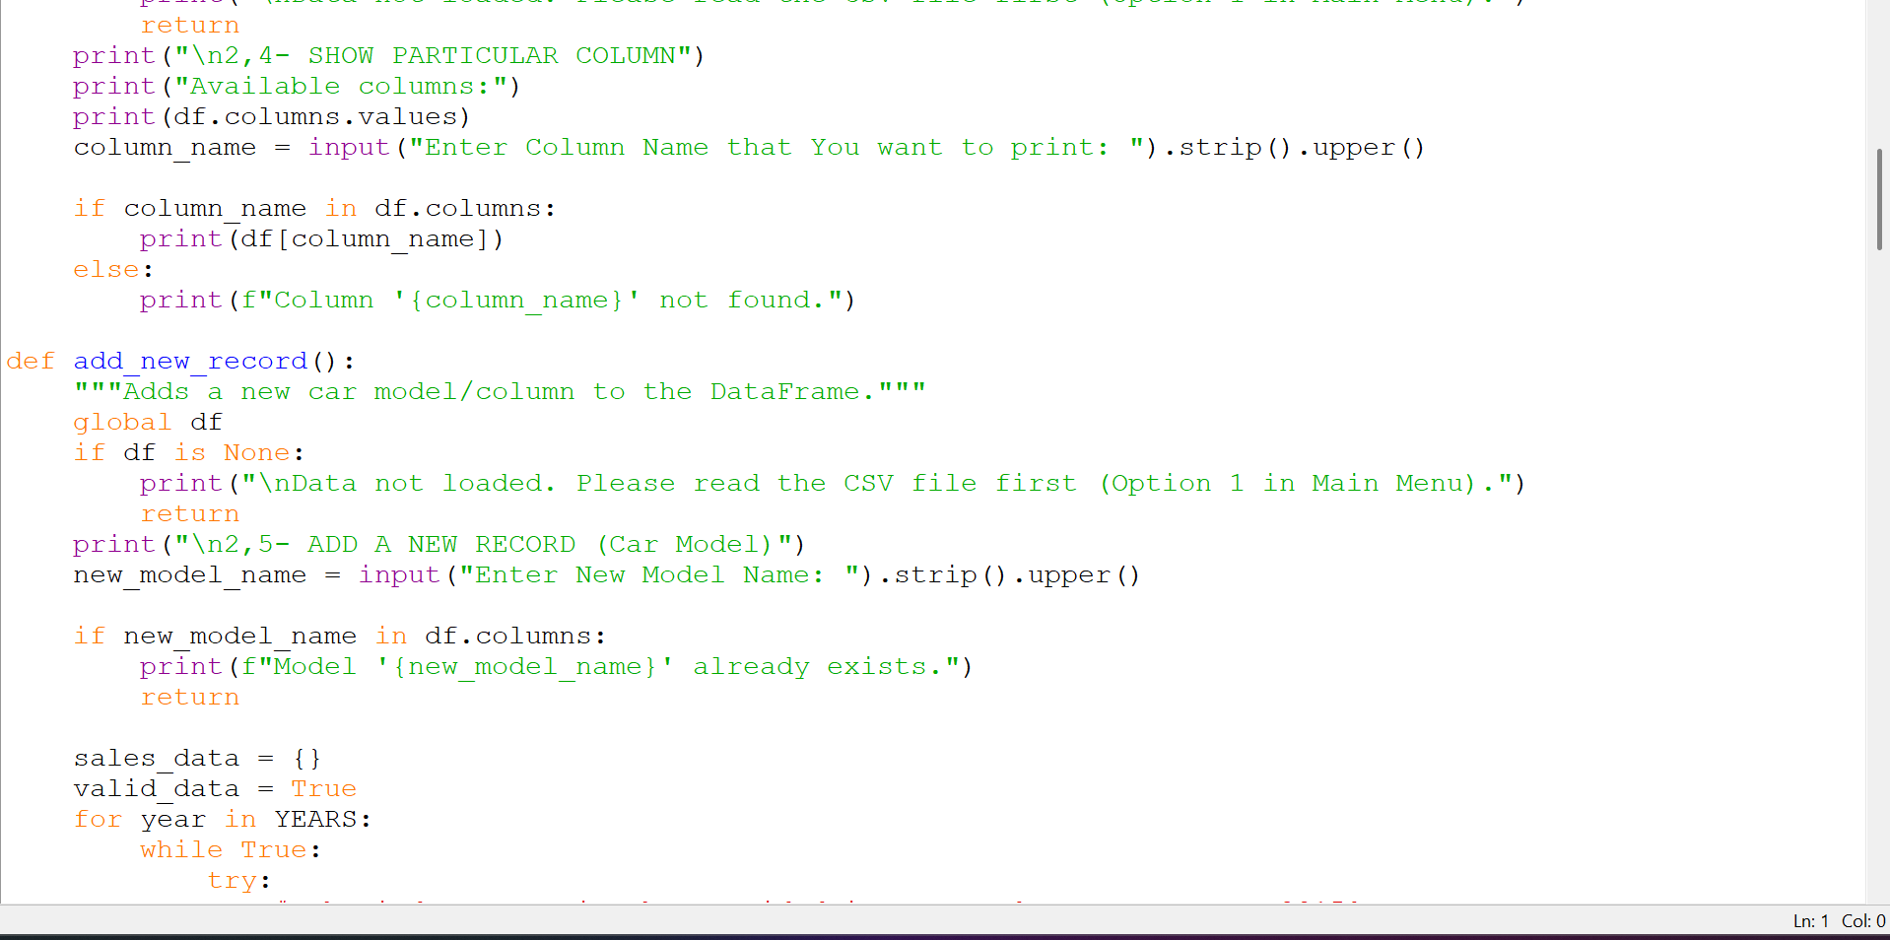

Slide 15
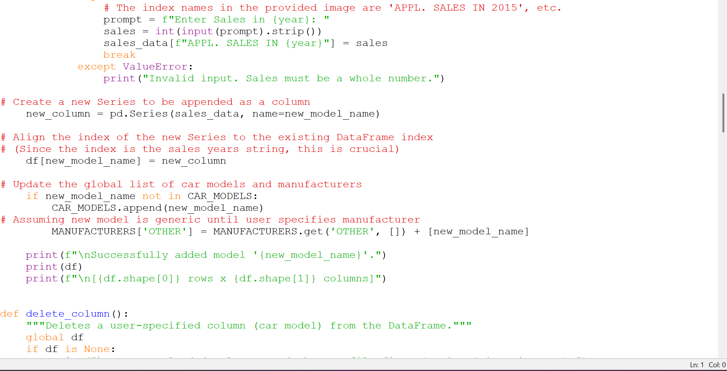

Slide 16
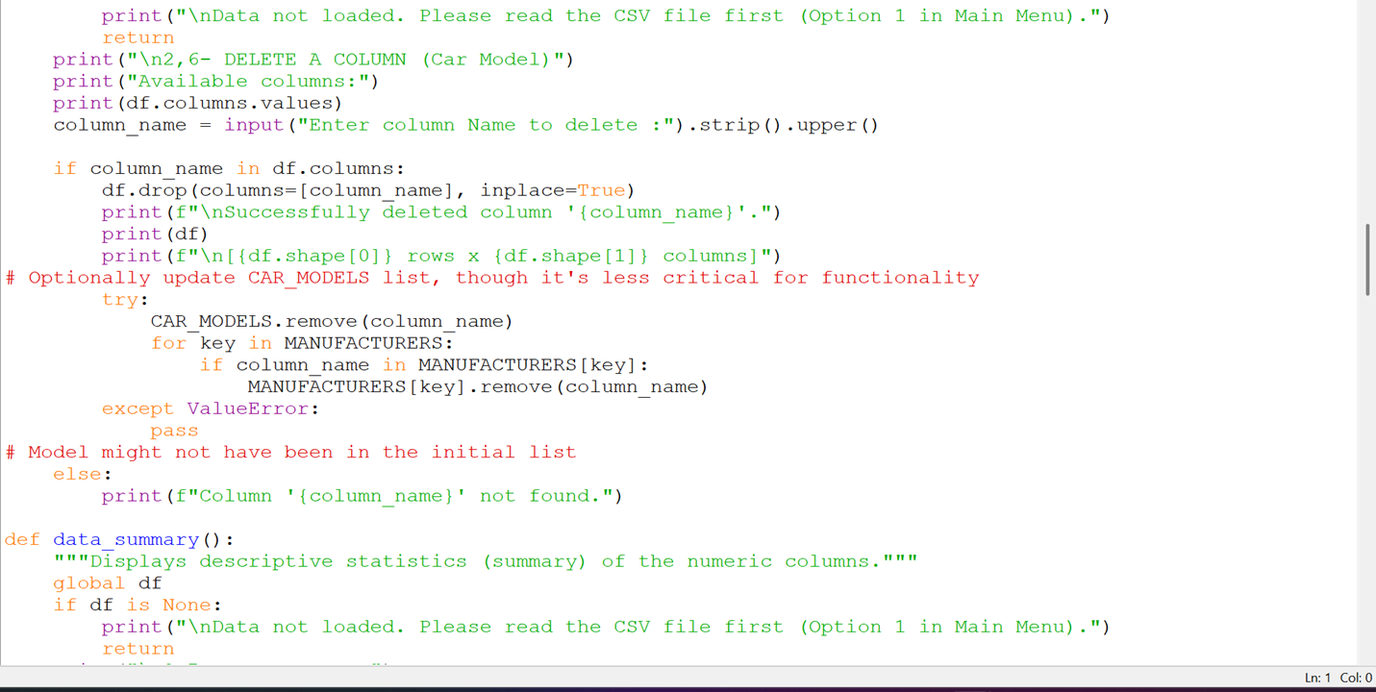

Slide 17
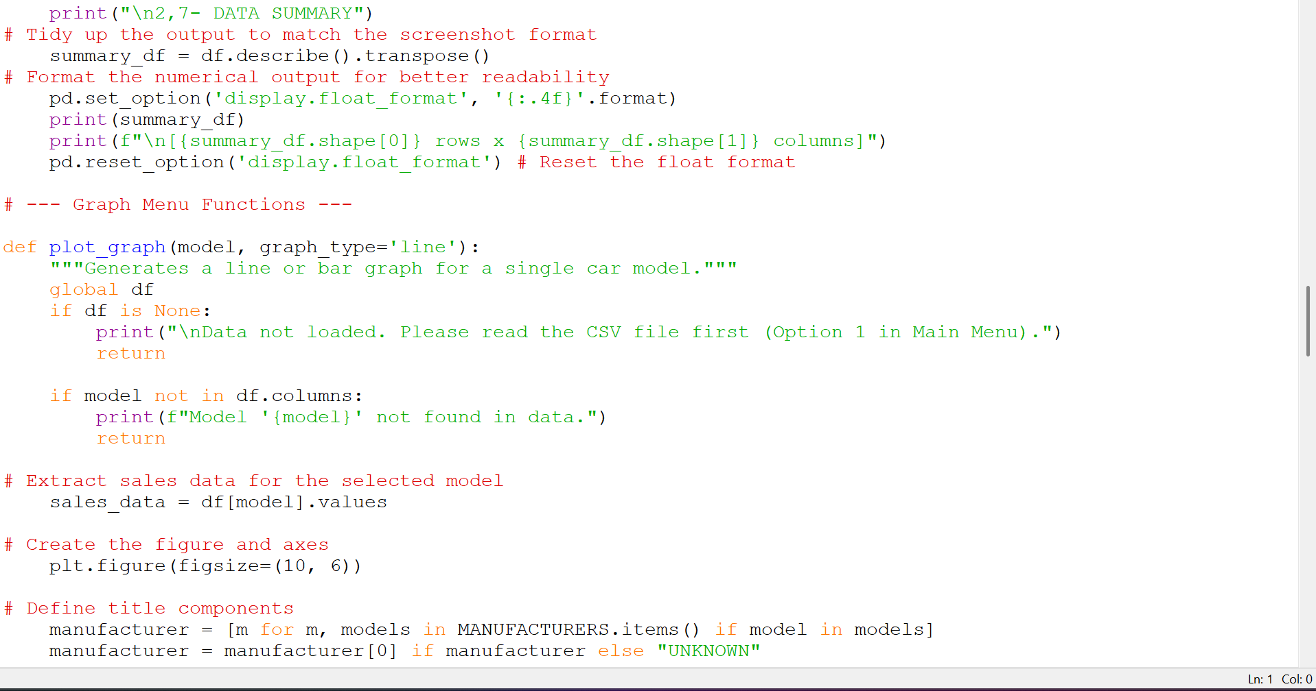

Slide 18
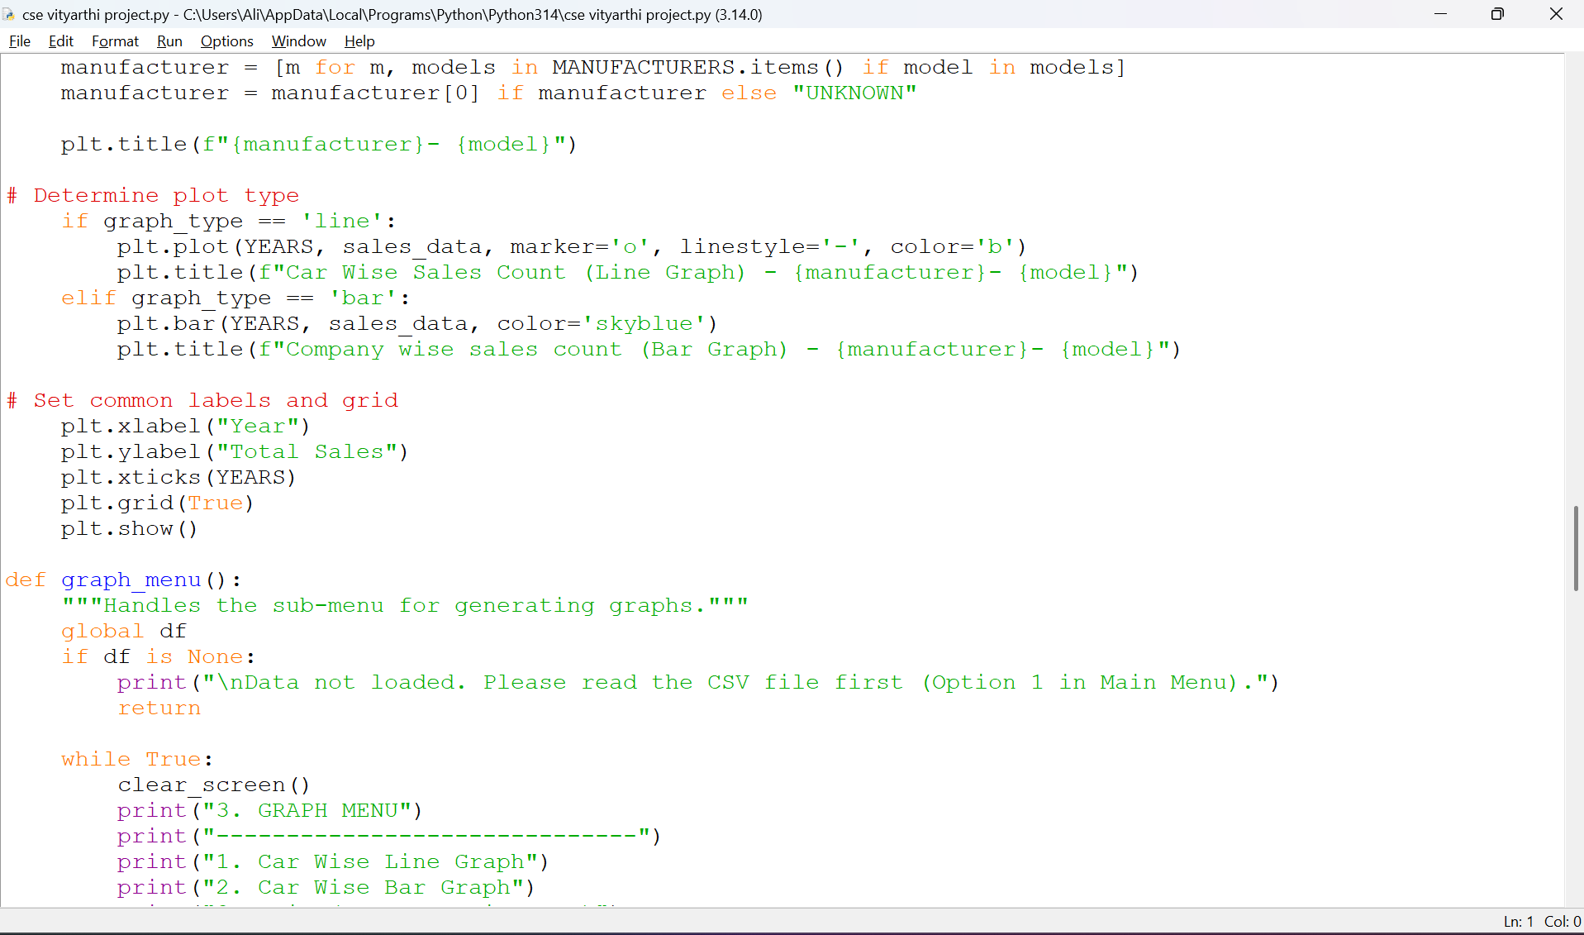

Slide 19
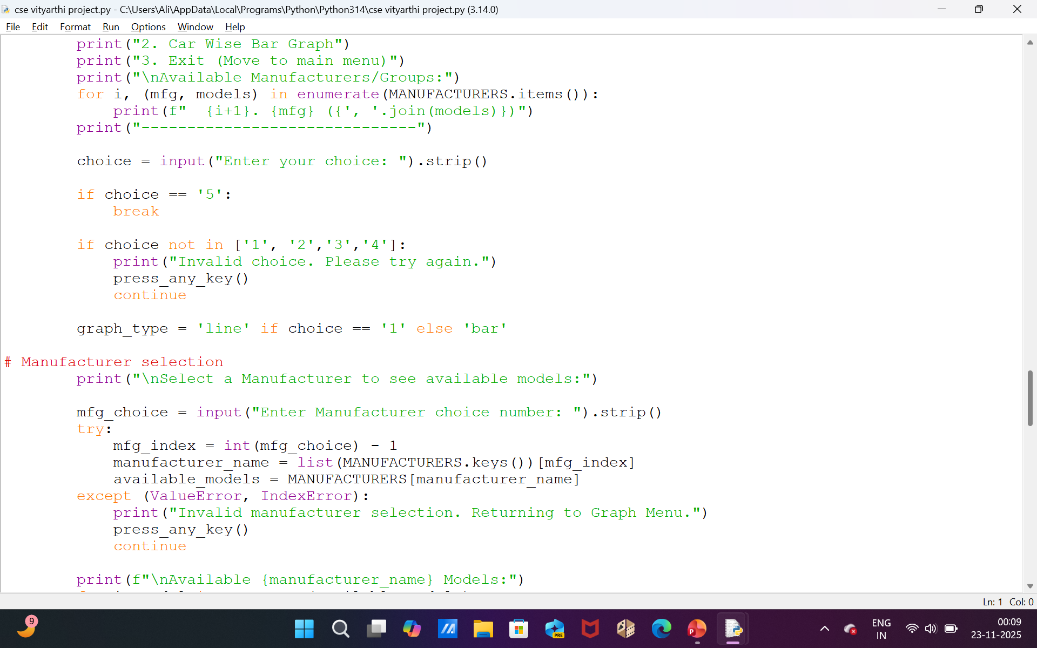

Slide 20
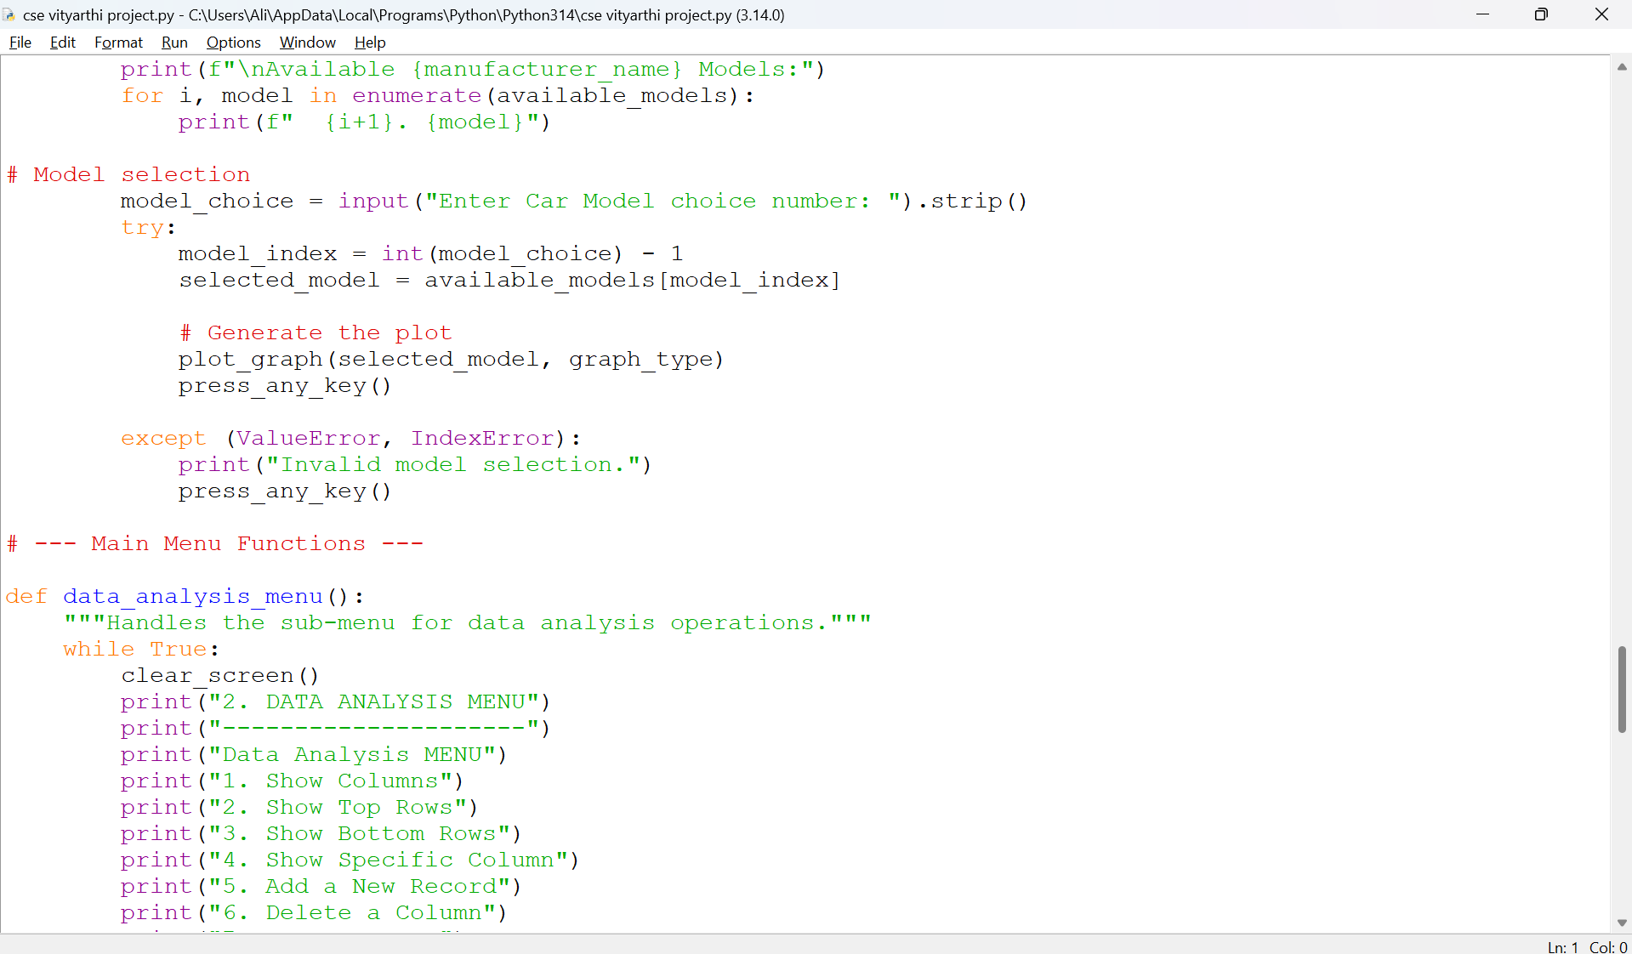

Slide 21
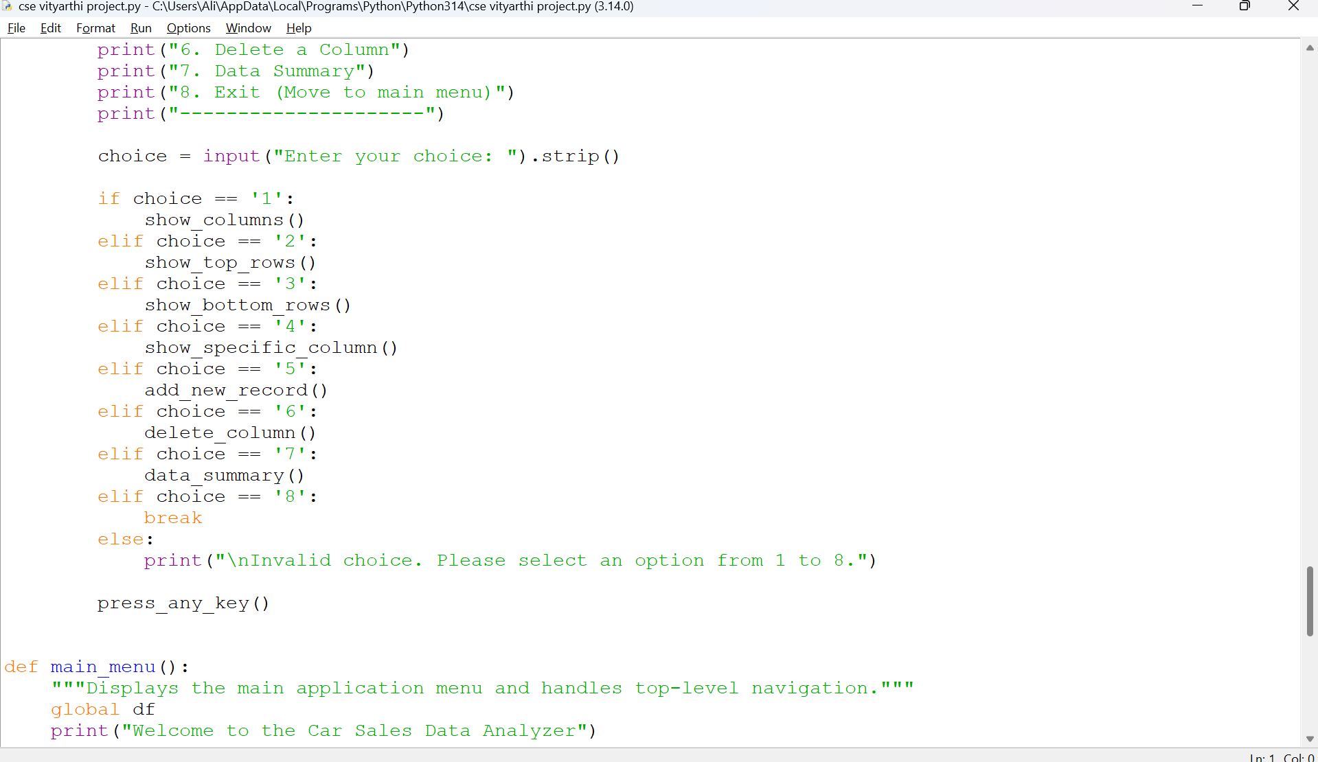

Slide 22
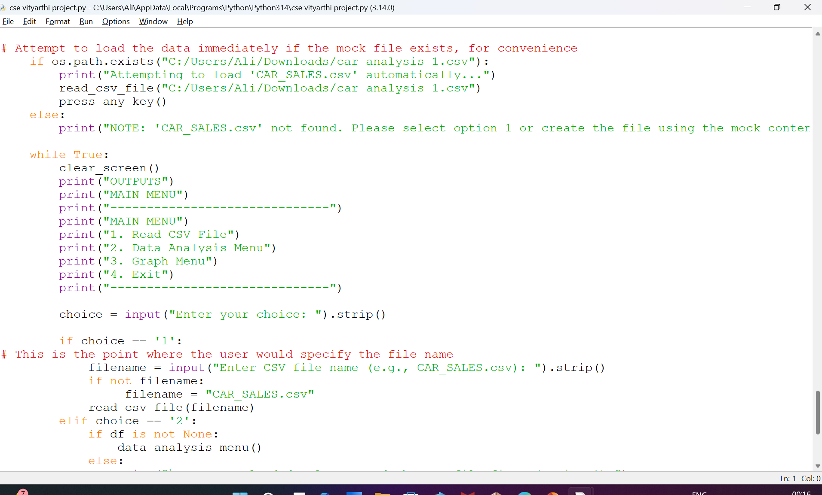

Slide 23
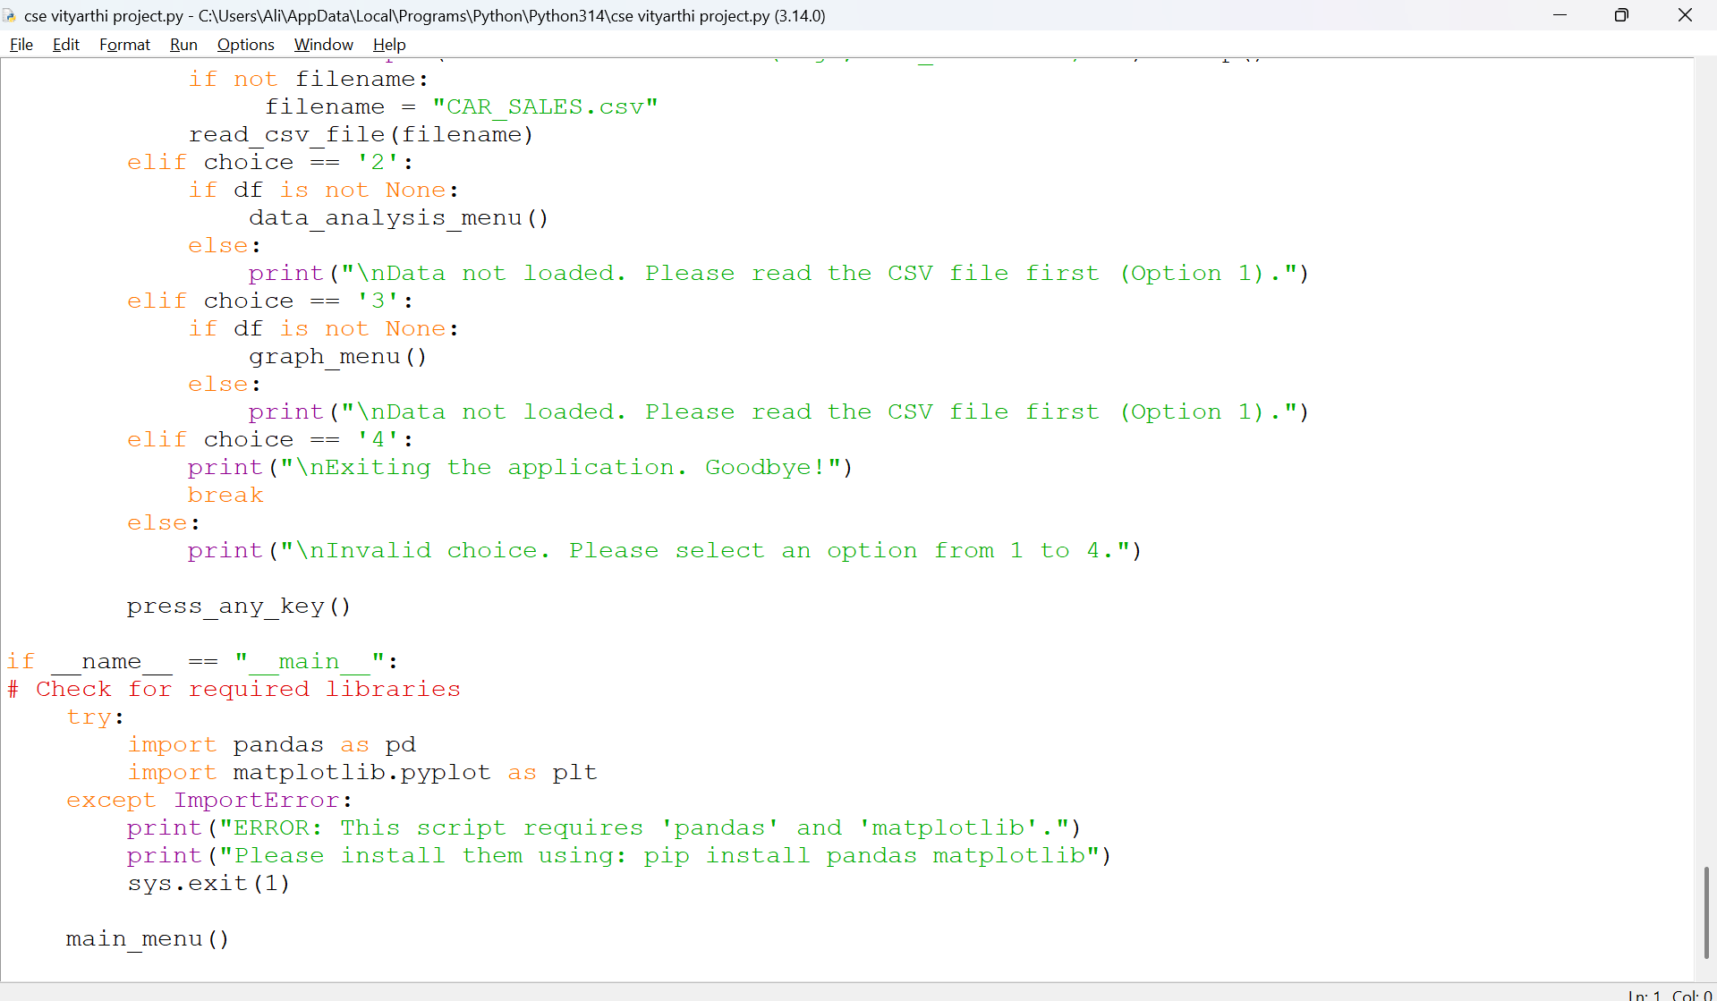

Slide 24
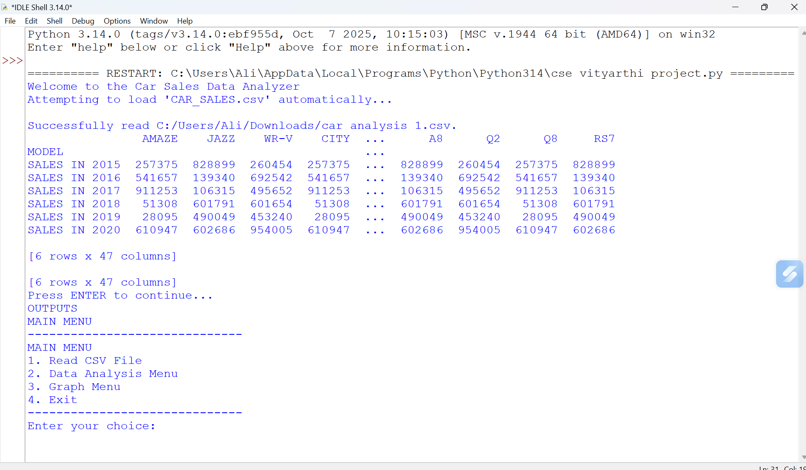

Slide 25
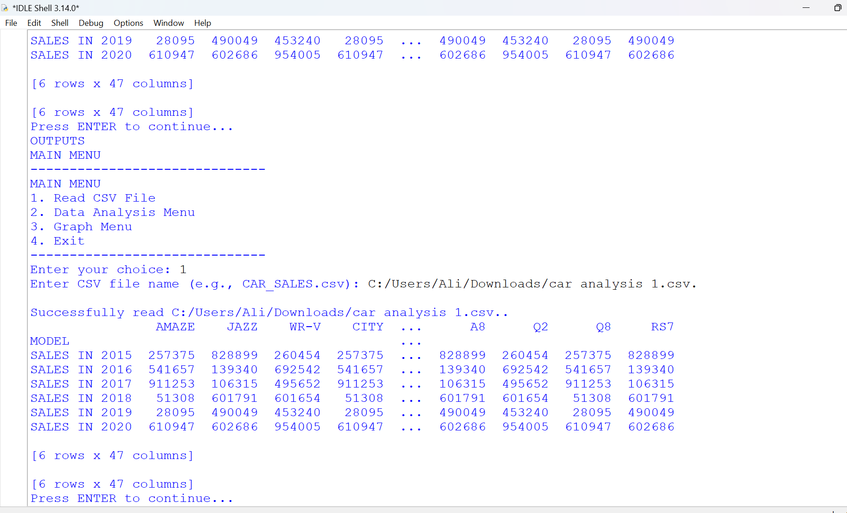

Slide 26
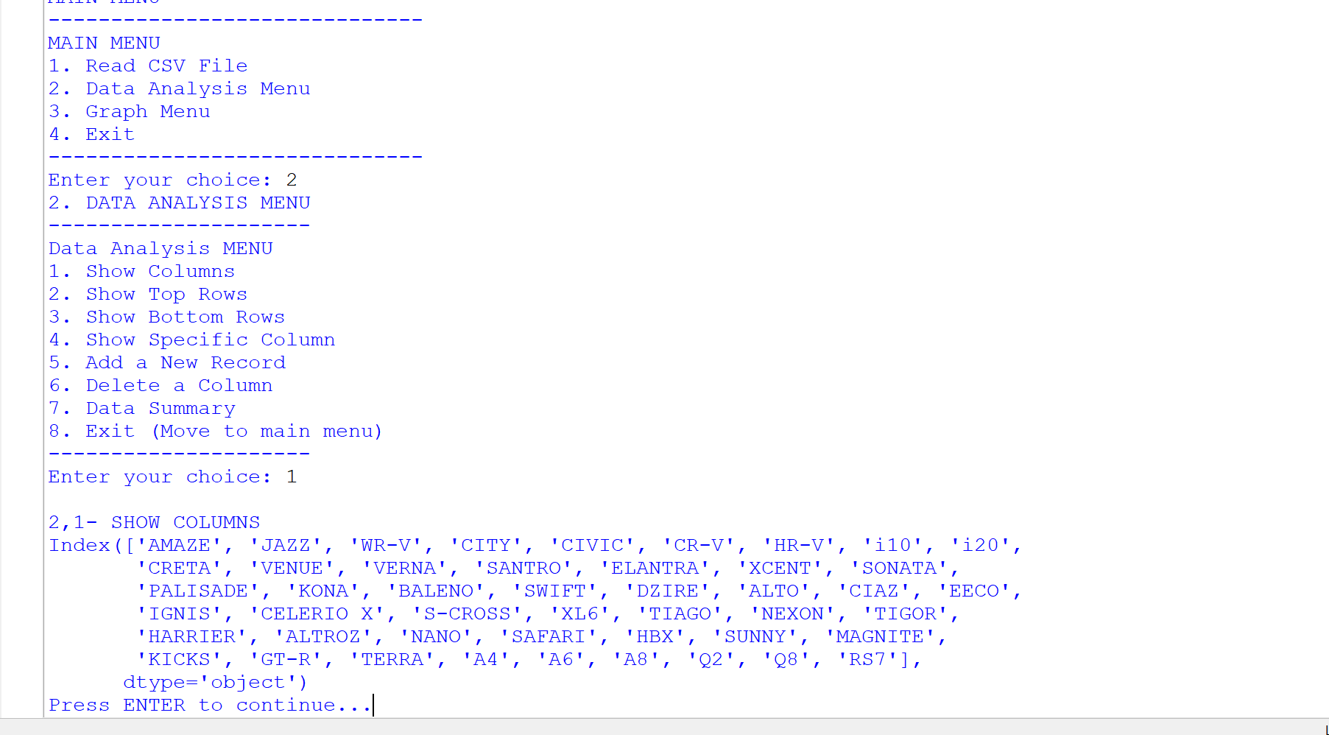

Slide 27
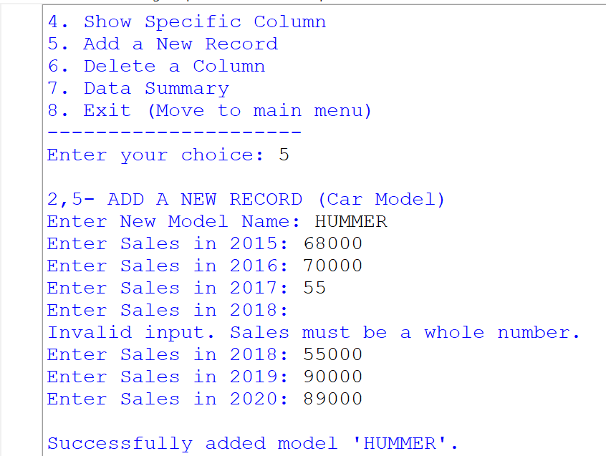

Slide 28
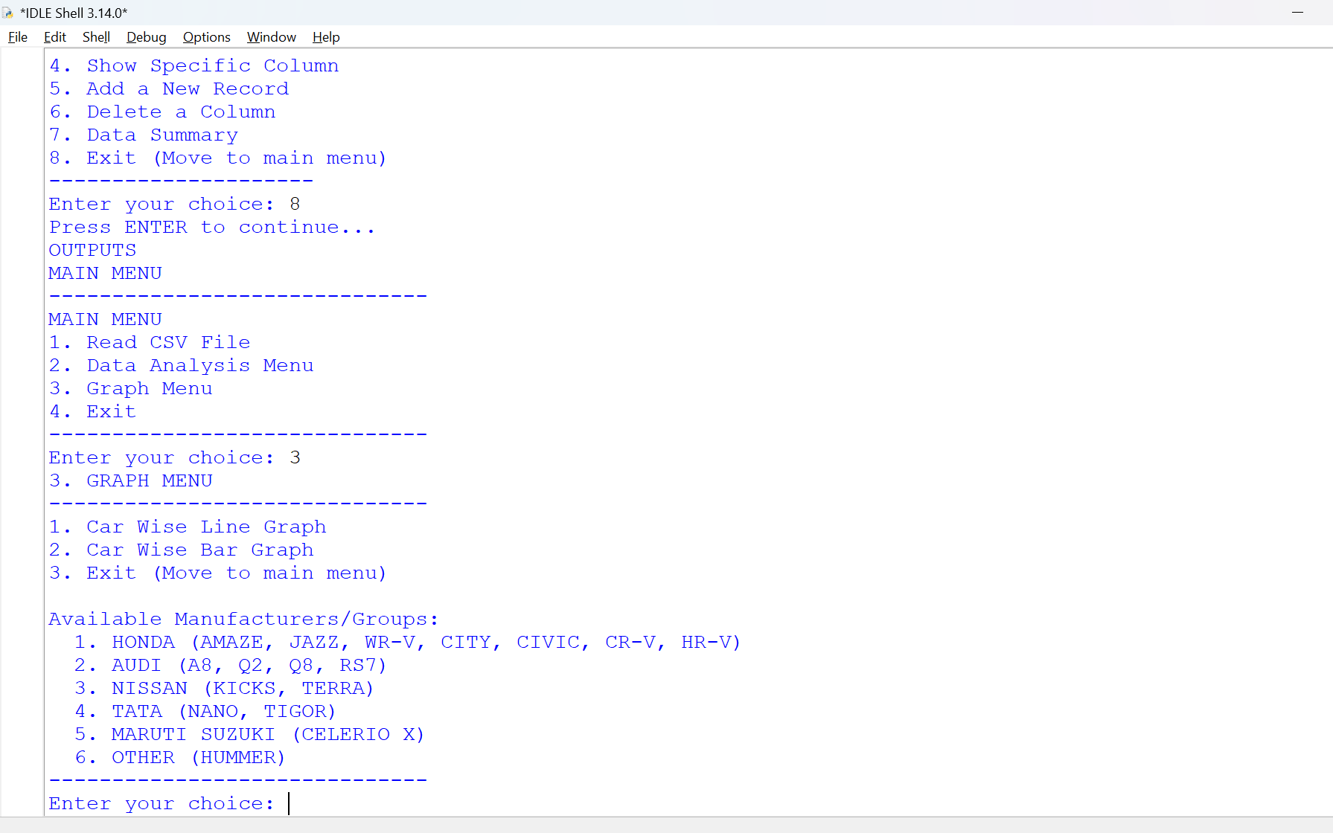

Slide 29
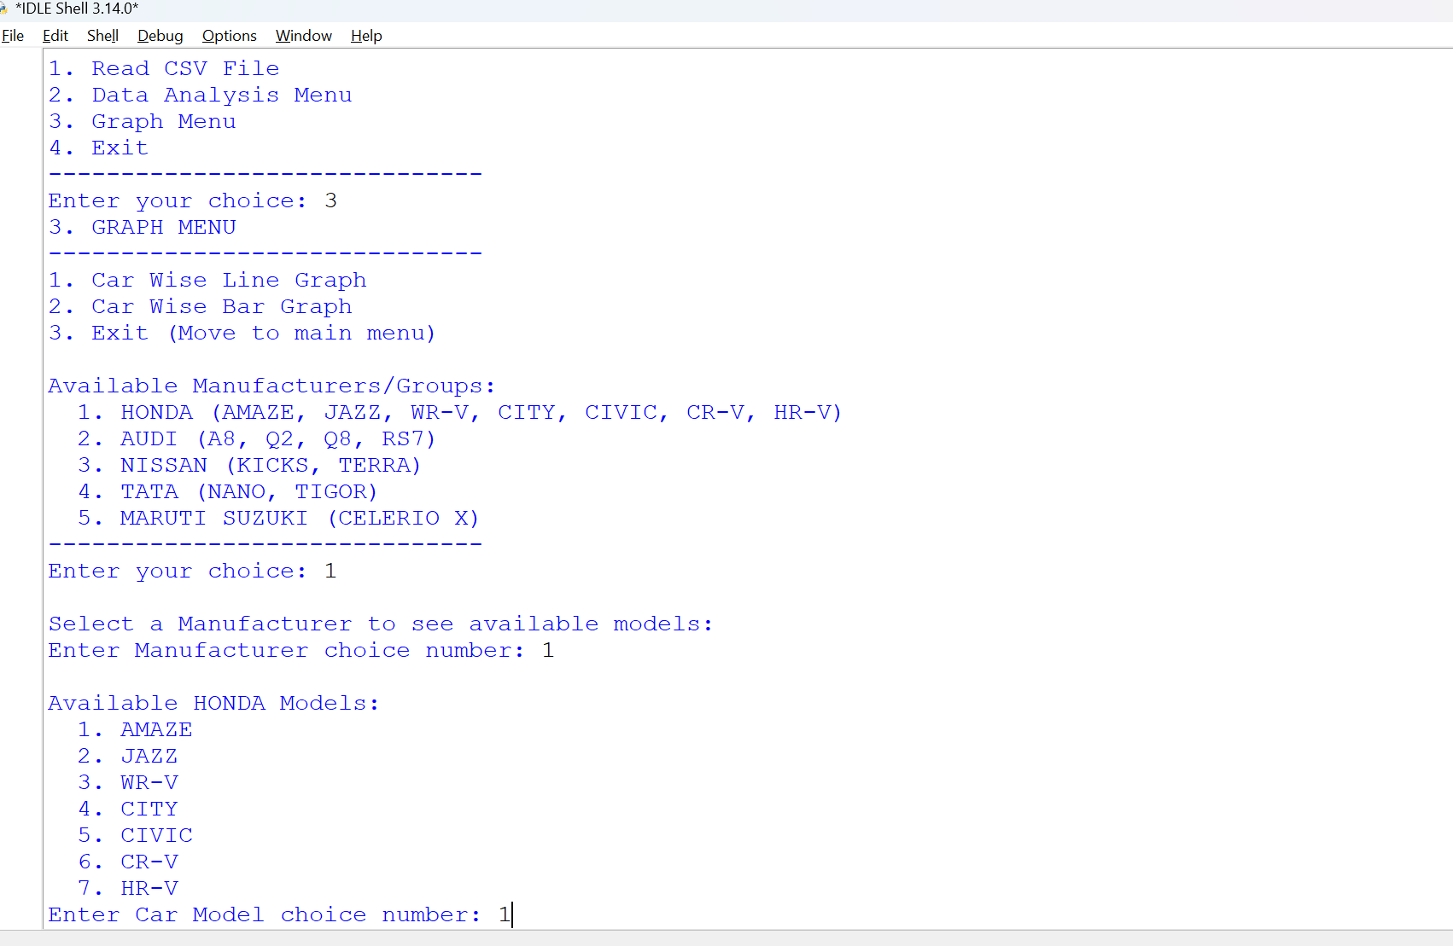

Slide 30
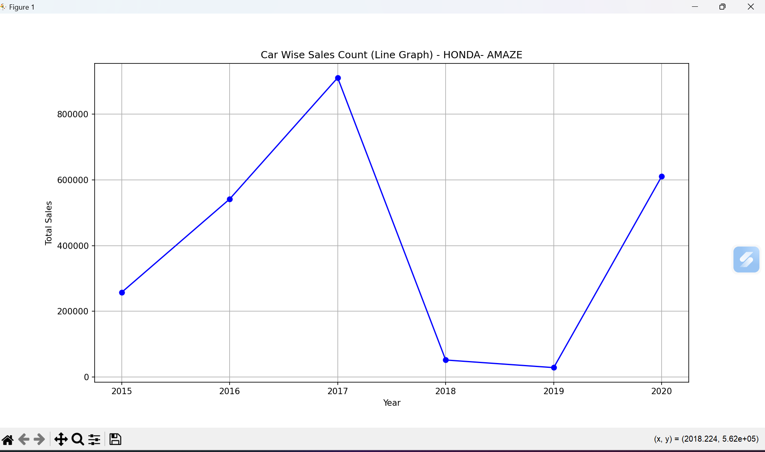
LINE GRAPH

Slide 31
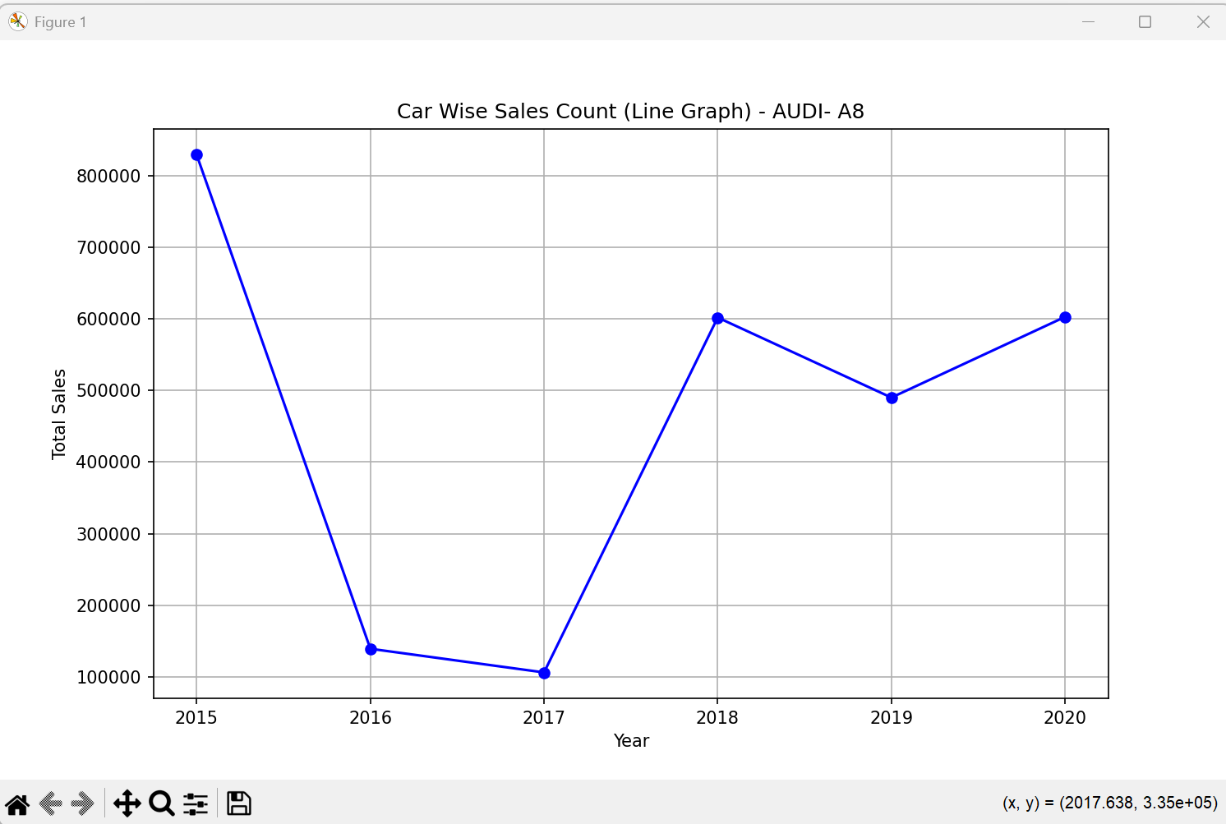
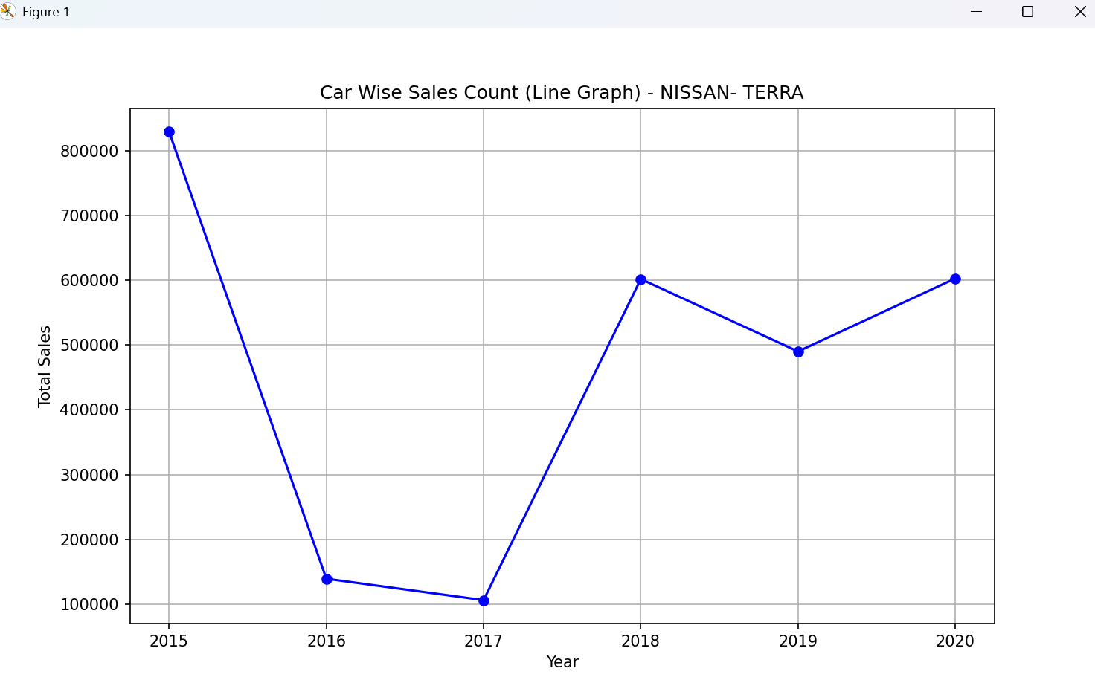

Slide 32
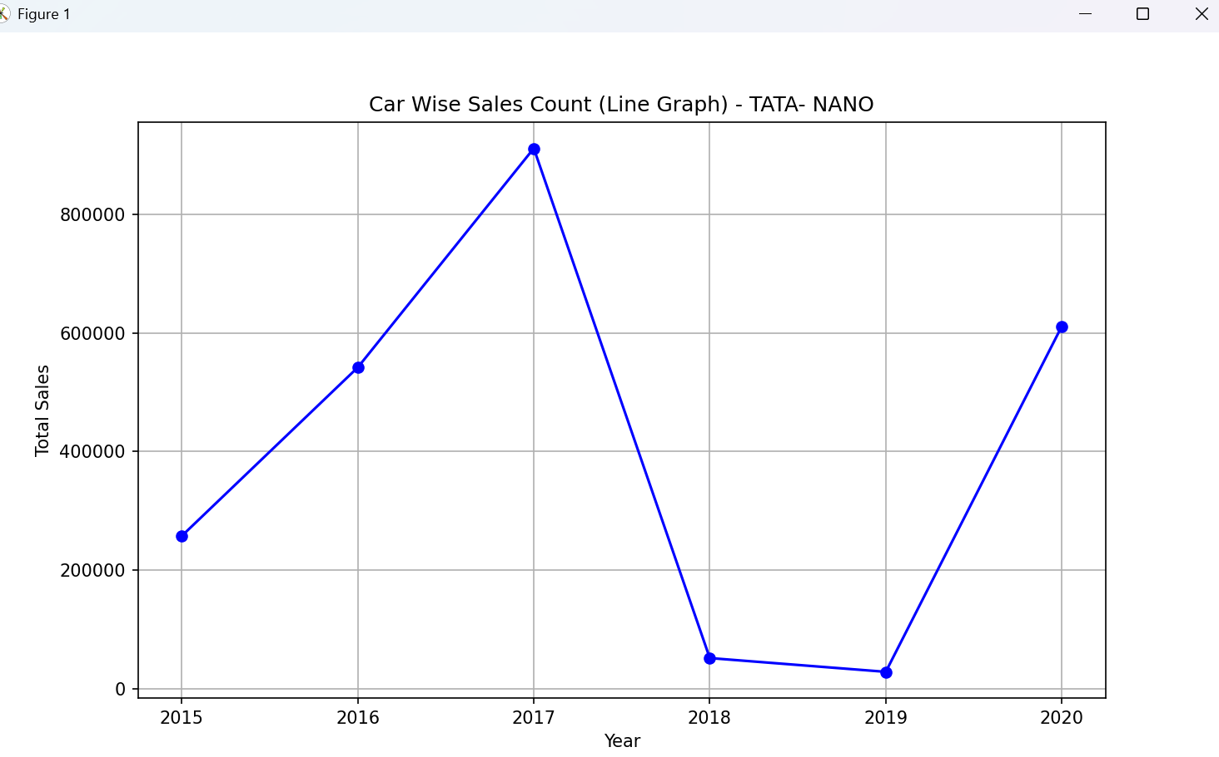
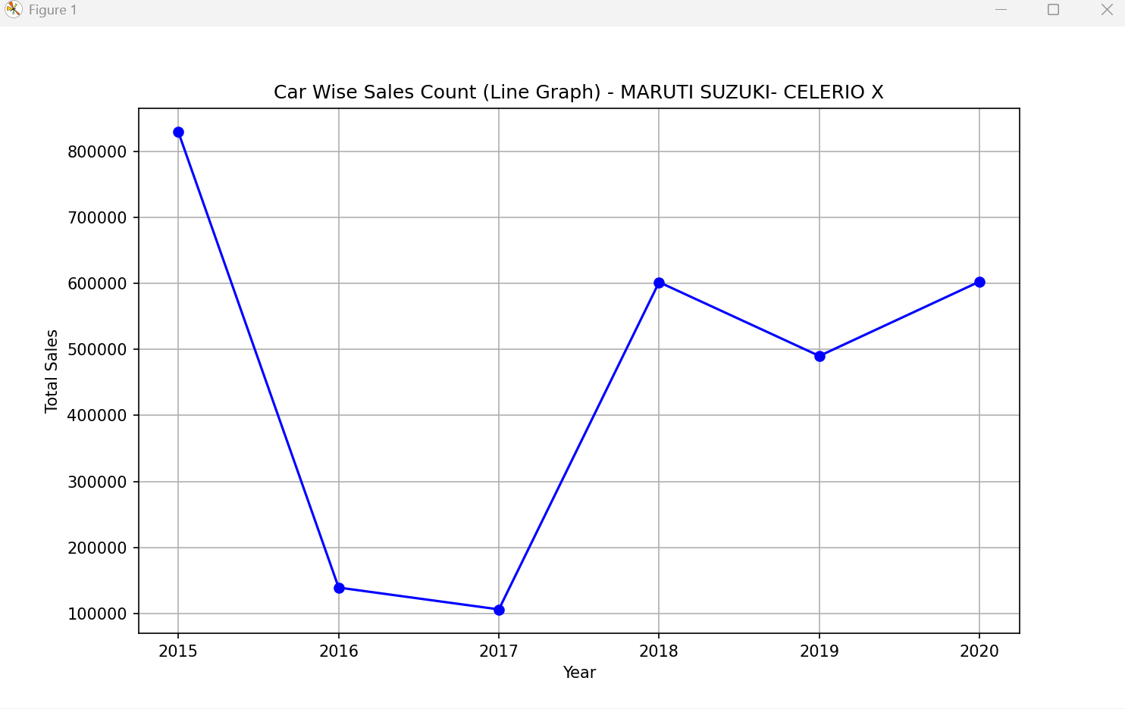

Slide 33
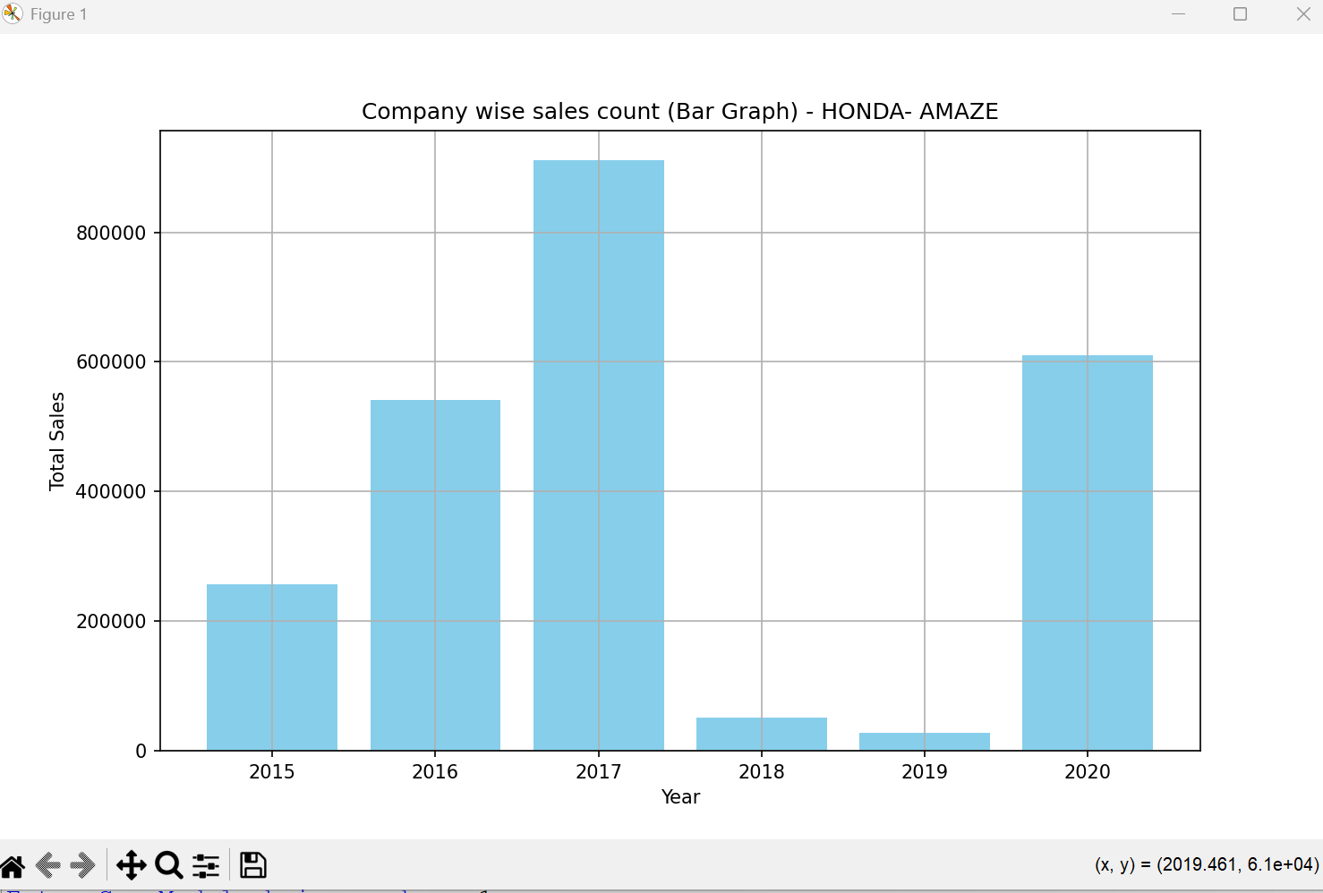
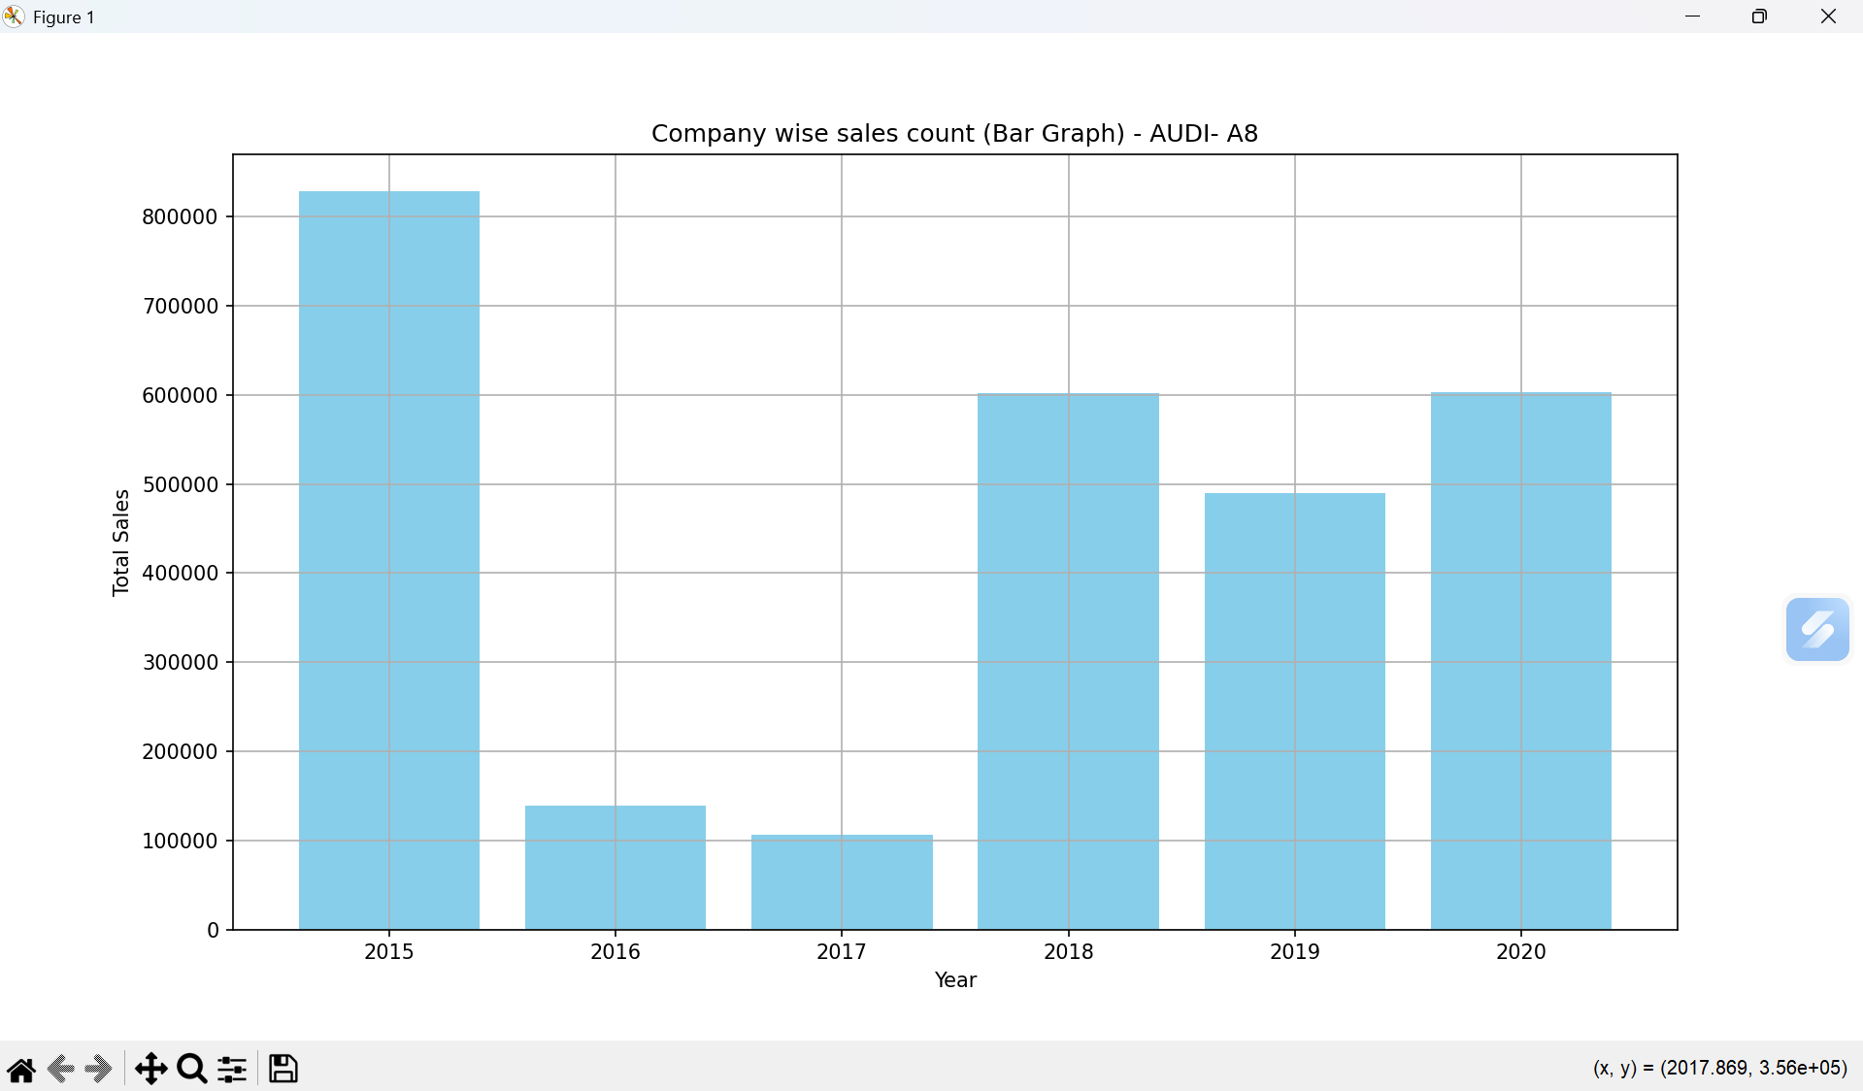
BAR GRAPH

Slide 34
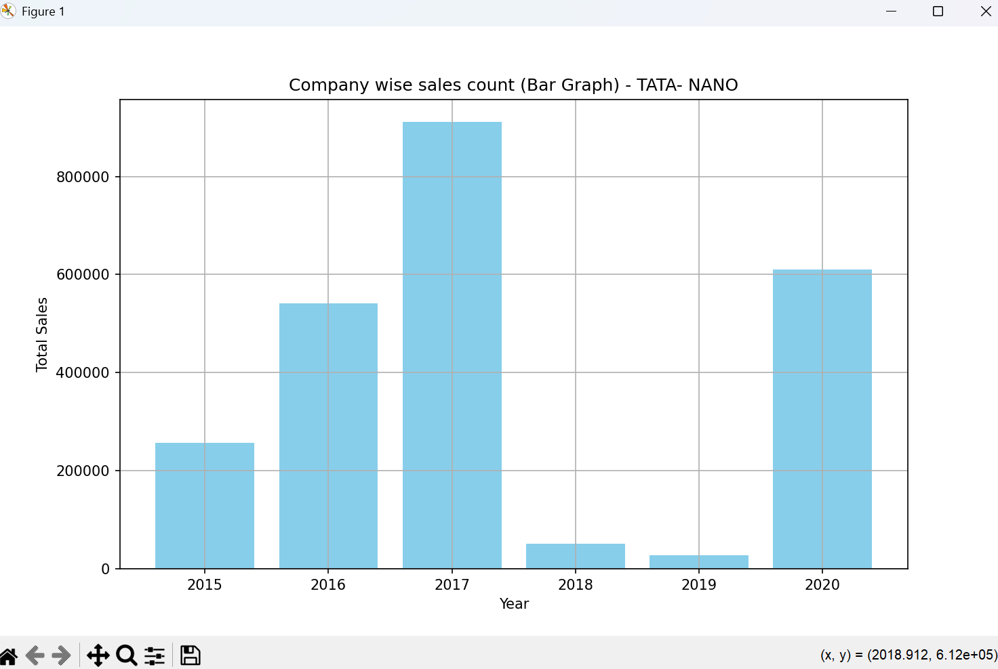
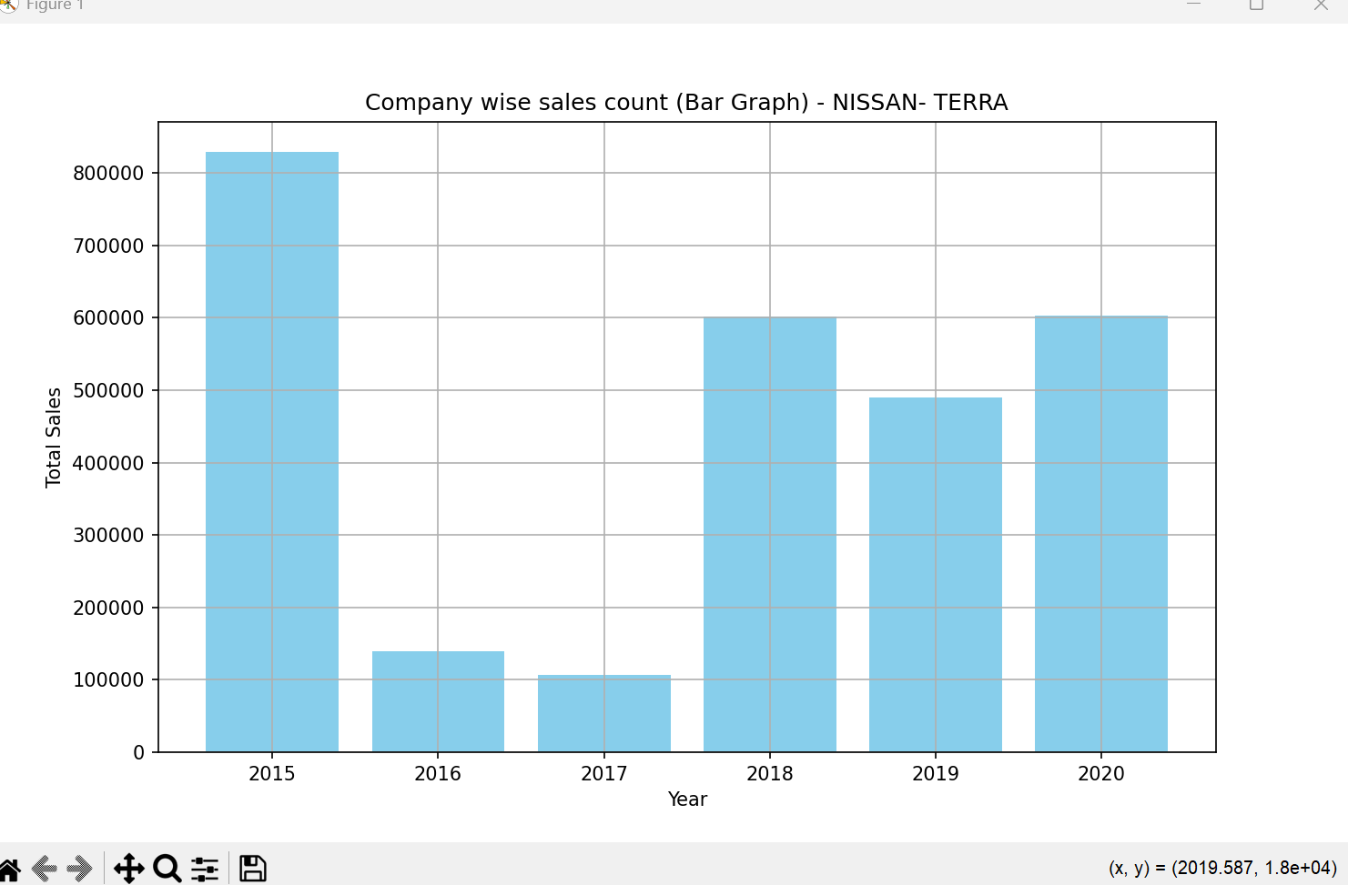

Slide 35
